Slide 1


An Introduction to
City Service Delivery Assessment (CSDA)
for City-wide Inclusive Urban Sanitation
Part 1: What a CSDA is, and where to use it
Part 2: How to develop and use a CSDA (next PowerPoint)
Inclusive Sanitation in Practice
for healthy equitable cities
Isabel Blackett and Peter Hawkins – www.incsanprac.com
Notes:
Welcome to this introduction to developing and using a City Service Delivery Assessment.
Isabel and I will take you through the main features of this tool

Slide 2
Overview
Part 1 – What is a CSDA?
What is a City Service Delivery Assessment (CSDA)?
  What does a CSDA do?
  The enabling environment
  Fitting the CSDA into the project cycle
  The CSDA output
How does the CSDA work?
Generating the scores
Quiz
( 28 slides / 16 minutes )
Part 2 – How to use a CSDA
Recap of Part 1
Who uses the CSDA and why?
How to Develop and use a CSDA
  CSDA options and process
  CSDA tool and user guide
  When and when not to use the CSDA
  Data sources and scoring
From assessment to prioritization and planning
Quiz
(21 slides / 17 minutes )
Notes:
It’s in two parts. Firstly, we’ll be looking at what a City Service Delivery Assessment is, and then in the second presentation at how to use it.
In this first part, we’ll briefly examine what a CSDA does. Then we’ll look in a bit more detail at the enabling environment which the CSDA is designed to assess, and see how it fits into a typical project cycle or programme.
We’ll examine the tool itself, looking at its output, how it’s structured and how the assessment scores are calculated and transformed into traffic-light indicators.
Finally, there’s a short quiz to see how well you’ve understood this presentation
Remember, you can pause the presentation at any time, or set it to advance the slides manually, so you can stop to think about the contents if you wish.

Slide 3
What is a City Service
Delivery Assessment?
Notes:
So what is a City Service Delivery Assessment?

Slide 4
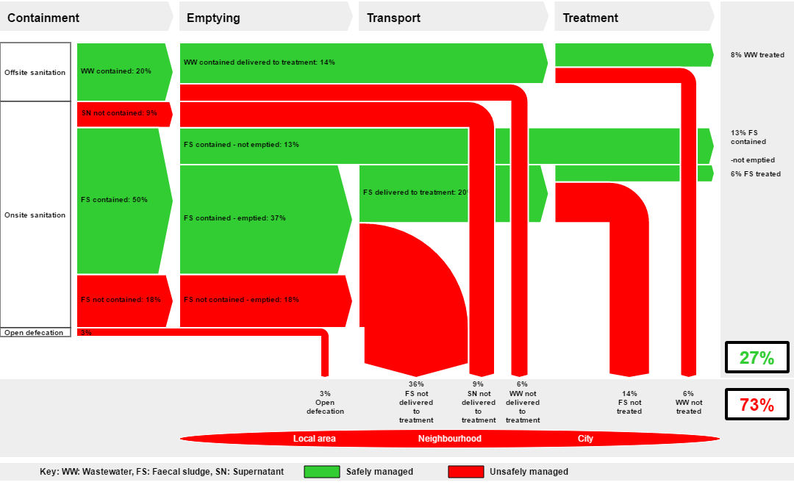
What does a City Service Delivery Assessment do?
A Faecal Waste Flow Diagram (SFD) provides an overview of how sanitation is working or not working in a city:
Shows % of population contributing to each faecal waste flow
Shows % safely managed and
% unsafely managed excreta
Reflects how inclusive the sanitation service is
Is effective for advocacy and awareness raising, but not technical design
What is causing these failures in sanitation?
Notes:
Let’s start with a brief look at another related tool. The Faecal Waste Flow Diagram, or SFD, is a widely used tool to visualise how well, or how badly, sanitation is working overall in a city.
The width of the arrows corresponds to the population whose faecal waste follows a safe or unsafe pathway. It also reflects how inclusive the sanitation service is, and often shows a small proportion being served by sewerage (at considerable cost to the public) and a large proportion by poorly functioning non-sewered systems, usually self-funded.
Because it tells the overall story but with minimal technical detail, it is primarily an advocacy and prioritization tool – and not suitable for system design.
The green arrows tell us the proportion of the population whose waste is safely managed.
[click]
The red arrows show the extent of unsafe sanitation, but they don’t tell us why the sanitation system is failing.

Slide 5
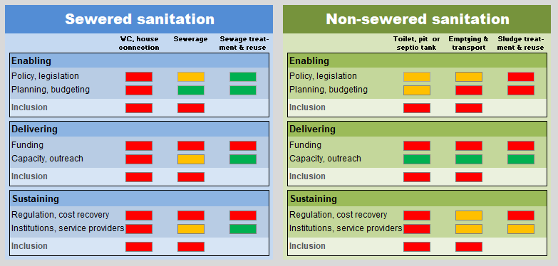
What does a City Service Delivery Assessment do?
A City Service Delivery Assessment (CSDA) assesses why this is happening:
  Facilitates assessment of the enabling environment for Citywide Inclusive Sanitation (CWIS)
  Generates graphics to support a systematic process for working with stakeholders to build consensus
  Separately addresses both sewered and non-sewered sanitation
  Includes an Action Checklist to help stakeholders identify and prioritise actions to improve sanitation
Notes:
Explaining why, is the purpose of the City Service Delivery Assessment.
[click 1]
The tool supports the assessment of the enabling environment for City-wide Inclusive Sanitation using a series of structured questions.
[click 2]
Like the SFD, it generates simple graphics to support a systematic process for working with stakeholders and inform a dialogue to build consensus for action.
[click 3]
It addresses sewered and non-sewered sanitation separately, as they are usually provided by different stakeholders, in quite different ways.
[click 4]
It also includes an Action Checklist to help stakeholders identify and prioritise actions to improve sanitation on the basis of the structured assessment.

Slide 6
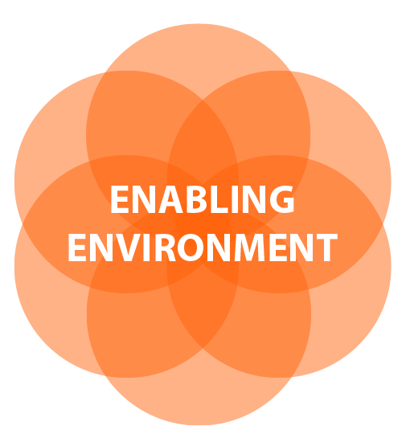
The enabling environment
Policies and Coordination mechanisms to deliver citywide inclusive sanitation
Institutions with clearly defined Roles, Accountability mechanisms and Incentives
Legal and Regulatory framework, backed by Monitoring and Enforcement
  Communication with service users to understand needs and promote services
Planning and Financing systems, including smart Subsidy mechanisms
Skills and Capacity to deliver services, in both public and private sectors
Notes:
This slide summarises six main components of the enabling environment which has to be in place to deliver effective sanitation services, and which the CSDA is designed to assess.
Spend a while looking at the components before moving on. Think about what each one means in the city you are living or working in.

Slide 7
Roles in the enabling environment
National Enabling Environment
Agree institutional roles and mandates
Policy and coordination
Regulation, norms and legislation
Planning, monitoring and finance/subsidy
Capacity building and technical assistance
Accountability mechanisms
and incentives
Local Governance Functions
Planning and coordination
Legislation and enforcement
Housing policy and land tenure
Finance and subsidy mechanisms
Capacity building for local services
Sanitation & hygiene promotion & monitoring
Community Engagement
User consultation and feedback
Planning and setting service levels
Sanitation promotion and marketing
possible utility role
Individual Services
Sludge & container removal
Public toilets
Toilet construction
Hardware supplies
Shared Services
Faecal sludge treatment
Sewerage operation
Drainage management
Solid waste management
Infrastructure Dev’t
Sewerage
Drainage
Primary water supply
Slum upgrading
Private Sector Public Sector
Notes:
Let’s look in a little more detail at how these components fit together.
[click 1]
Sanitation consists of a wide range of services, provided to individuals or shared by the community as a whole, usually supported by major infrastructure.
[click 2]
These can all be provided in principle by the public or the private sector. However, services provided to individuals, such as toilet construction or desludging often work best with small private enterprises, while expensive major infrastructure usually requires government backing.
[click 3]
In order to ensure that individual and, to some extent, shared sanitation services meet user needs and aspirations, and that available services are used to maximum effect, there is a need for strong community engagement using a range of mechanisms.
[click 4]
Local government has a central role to play in delivering sanitation, with responsibility at local level for all aspects, although many may be delegated to other stakeholders.
[click 5]
Higher levels of government also have a role to play, by empowering local government with the tools and resources it needs to discharge its responsibilities
[click 6]
There is an increasing tendency to expand utility roles, which often already include sewered sanitation, to cover non-sewered sanitation. If the utility is financially sound, this allows for cross-subsidy from water supply to sanitation, and some economies of scope.
[click 7]
With all these different stakeholders playing different roles, accountability mechanisms and incentives are critical to ensuring that all the necessary functions are carried out.

Slide 8

The enabling environment in the project cycle
Pre-concept
Advocacy
Infrastructure and Services
What are the problems?
Enabling Environment
What is the physical scope of the problems?
Why is the
situation like this?
Scoping
Data collection
Project concept
What is the necessary enabling environment?
What are the technical
and service options?
stakeholder dialogue
Selection of technical
and service options
Project implementation
Design, supervision and services development
Institutional, financial & regulatory development
Notes:
A typical project follows this cycle.
[click 1]
The first step is to diagnose the problems so that the right solutions can be identified to address them. As at all stages of the project cycle, the relevant stakeholders must be involved.
[click 2]
Clearly, infrastructure and services will be part of the solution.
[click 3]
But as we’ve seen, failures in the enabling environment are just as important, and need to be identified so that solutions can be found.
[click 4]
The technical and institutional solutions depend on each other and need to be conceived together before detailed design can be undertaken.

Slide 9
Where the City Service Delivery Assessment fits
What are the problems?
SFD
Pre-concept
Advocacy
Infrastructure and Services
What are the problems?
Enabling Environment
Why is the
situation like this?
CSDA
What is the physical scope of the problems?
Why is the
situation like this?
Scoping
Data collection
Project concept
What is the necessary enabling environment?
What are the technical
and service options?
stakeholder dialogue
Selection of technical
and service options
Project implementation
Design, supervision and services development
Institutional, financial & regulatory development
Notes:
As mentioned earlier, the SFD provides a good starting point for the process. The CSDA would then be undertaken to assess the scope of the problems in the enabling environment, and suggest interventions that might be considered.

Slide 10
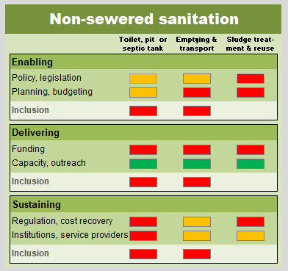
CSDA output
A CSDA produces a structured diagnosis of institutional barriers to sanitation service delivery, based on 3 pillars:
  Enabling: policy, legal and institutional environment
  Delivering: resources and mechanisms available to improve sanitation
  Sustaining: operating environment, funding and personnel needed to provide ongoing and sustainable sanitation services
It is summarised in a simple traffic light graphic, to facilitate stakeholder debate
Notes:
The CSDA is based on three pillars.
[click 1]
The enabling pillar examines the policy, legal and institutional environment.
[click 2]
The delivering pillar focuses on the resources and mechanisms available to improve sanitation.
[click 3]
And the sustaining pillar looks at the ability of the operating environment, funding systems and personnel, in their various institutions, to provide ongoing and sustainable sanitation services.
[click 4]
The assessments are converted into traffic-light graphics which provide a simple overview that can facilitate the stakeholder discussions on the enabling environment.
Now Isabel will explain how the City Service Delivery Assessment works.

Slide 11
How does a City Service
Delivery Assessment work?
Notes:
Let’s take a look at how the CSDA is put together, and how it works

Slide 12

Structure of the CSDA
$$
Assessment of institutional barriers to sanitation service delivery
Resources into services
Notes:
As we’ve already seen, the CSDA assesses the institutional barriers to sanitation service delivery – or how effectively resources are turned into sanitation services for people.

Slide 13
Structure of the CSDA
$$
Assessment of institutional barriers to sanitation service delivery
  Asks objective questions about service delivery mechanisms
Enabling
Policy, legislation
Planning, budgeting
Inclusion
Delivering
Funding
Capacity, outreach
Inclusion
Resources into services
Sustaining
Regulation,
cost recovery
Service providers
Inclusion
Notes:
It does this based on a structured series of questions.
The questions are divided into three pillars. Each one is composed of two building blocks specific to the pillar, and a third focusing on inclusion – is the system working for poor people, women and other disadvantaged groups?

Slide 14
Structure of the CSDA
$$
Toilet,
Containment
Emptying, Conveyance
Treatment, Re-use
Assessment of institutional barriers to sanitation service delivery
  Asks objective questions about service delivery mechanisms
  Along a simplified service chain
Enabling
Policy, legislation
Planning, budgeting
Inclusion
Delivering
Funding
Capacity, outreach
Inclusion
Resources into services
Sustaining
Regulation,
cost recovery
Service providers
Inclusion
Notes:
The questions are answered separately for the different parts of a simplified sanitation service chain:
the toilet, and the pit or septic tank if it is a non-sewered facility;
the collection and transport of faecal sludge, or sewerage; and
the treatment and possible re-use of the faecal sludge or wastewater.

Slide 15
Structure of the CSDA
$$
Toilet,
Containment
Emptying, Conveyance
Treatment, Re-use
Assessment of institutional barriers to sanitation service delivery
  Asks objective questions about service delivery mechanisms
  Along a simplified service chain
  Undertaken with stakeholders based on evidence
Enabling
Policy, legislation
Planning, budgeting
Inclusion
0.5
0.5
0
0.5
0
0
0
0
Delivering
Funding
Capacity, outreach
Inclusion
0
0
0
Resources into services
1
1
1
0
0
Sustaining
Regulation,
cost recovery
Service providers
Inclusion
0
0.5
0
0
0.5
0.5
0
0
0
Notes:
The scores for the questions are attributed working in close collaboration with the stakeholders, and produce the traffic-light graphic.

Slide 16
Structure of the CSDA
$$
Toilet,
Containment
Emptying, Conveyance
Treatment, Re-use
Assessment of institutional barriers to sanitation service delivery
  Asks objective questions about service delivery mechanisms
  Along a simplified service chain
  Undertaken with stakeholders based on evidence
  Underlying questions should be adapted to the local context
Enabling
Policy, legislation
Planning, budgeting
Inclusion
0.5
0.5
0
0.5
0
0
0
0
Delivering
Funding
Capacity, outreach
Inclusion
0
0
0
Resources into services
1
1
1
0
0
Sustaining
Regulation,
cost recovery
Service providers
Inclusion
0
0.5
0
0
0.5
0.5
0
0
0
Notes:
Before discussing the questions, it is recommended to adapt them to the local context – for example the mandate of local government – as well as translating or adjusting terminology to ensure that all the stakeholders will understand their meaning.

Slide 17
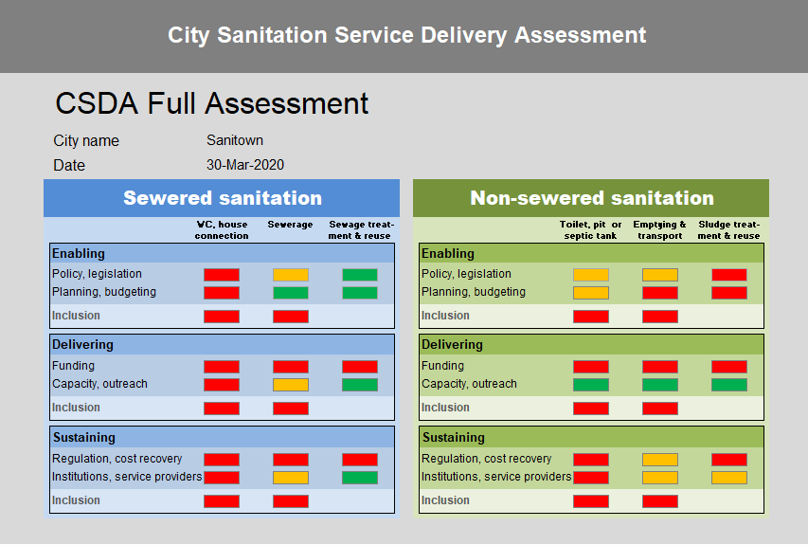
Separate assessments for sewered & non-sewered systems
Sewered and non-sewered systems assessed separately
due to different:
institutions and regulations involved
levels of development
strengths and weaknesses
actions needed
Notes:
Sewered and non-sewered systems are assessed separately due to the different institutions and regulations involved, levels of development, strengths and weaknesses, and the actions needed to make improvements.

Slide 18
Generating the scores
Notes:
Next, we’ll look at how the scores for the different pillars and building blocks are calculated.

Slide 19
Pillars, building blocks and questions
Pillar | Building block | Questions in the framework
Enabling | Policy | Policies, institutions, regulation
 | Planning and budgeting | Targets, budget lines
 | Inclusion | In planning and budgets
Delivering | Funding | Investment plan, adequacy, coordination
 | Capacity, outreach | Institutional capacity, staffing/autonomy, outreach
 | Inclusion | Technology, funding
Sustaining | Regulation and cost recovery | Staffing, staff development, health and safety, capacity building
 | Service providers | Marketing, service provider development
 | Inclusion | Growth, planning from evidence, outcomes
Notes:
As we’ve already seen, the CSDA has three pillars – enabling, delivering and sustaining services. These are shown on the left side of the table. Each pillar is divided into three building blocks, as shown in the middle column. A score for each building block is calculated by the stakeholders, by answering a series of objective questions.
[click 1]
For example, in the ‘Enabling’ pillar under the ‘Policy’ building block, the questions address policy, institutions and regulation.
[click 2]
Or, taking another example, the building block ‘Inclusion’ in the ‘Developing’ pillar asks questions about the availability of different affordable technical options and whether funding is available for services to support poor and vulnerable people.

Slide 20
Example CSDA question and scoring criteria
Question | Toilet, pit or septic tank | Emptying & transport | Sludge treatment and reuse | Scoring rubric
N.1.1 Policy: Is use of non-sewered sanitation services enabled by an appropriate, widely-known, acknowledged and available national or local policy? |  |  |  | 1 Policy is appropriate, widely-known, acknowledged and available 0.5 Policy is appropriate, but not widely-known, acknowledged or available; or exists only as a guideline or strategy without legal force 0 Policy is not available, or inappropriate to the context
Notes:
Here’s an example of a question from the ‘Policy’ building block of the ‘Enabling’ pillar for non-sewered sanitation services: “Is use of non-sewered sanitation services enabled by an appropriate, widely-known, acknowledged and available national or local policy?” It illustrates that, although the CSDA is focused on the city, national and regional or state policies may also apply.
On the right side you can see the scoring rubric. If there’s a relevant and appropriate policy (or draft) that’s acknowledged and readily available, you score one. If there’s an appropriate policy or draft but it’s not acknowledged or not widely available, then score half. If there’s no policy or it’s inappropriate, then score zero.
Each question is answered three times – once for each stage of the sanitation chain.

Slide 21
Example CSDA question and scoring criteria
Question | Toilet, pit or septic tank | Emptying & transport | Sludge treatment and reuse | Scoring rubric
N.1.1 Policy: Is use of non-sewered sanitation services enabled by an appropriate, widely-known, acknowledged and available national or local policy? | 0 | 0.5 | 0.5 | 1 Policy is appropriate, widely-known, acknowledged and available 0.5 Policy is appropriate, but not widely-known, acknowledged or available; or exists only as a guideline or strategy without legal force 0 Policy is not available, or inappropriate to the context
Notes:
Once a number is typed into the spreadsheet, the appropriate colour will automatically appear.

Slide 22
Example CSDA question and scoring criteria
Question | Toilet, pit or septic tank | Emptying & transport | Sludge treatment and reuse | Scoring rubric
S2.7 Technology: Are there affordable, appropriate, safe and adaptable technologies available to meet the needs of poor and vulnerable people, according to the agreed definition? |  |  |  | 1 There are suitable options available to address the needs of most poor and vulnerable people 0.5 There are options that address the needs of some poor and vulnerable people, but they are not sufficient or complete 0 Options available to meet the sanitation needs of poor and vulnerable people are grossly inadequate
Notes:
Here’s a question from the ‘Inclusion’ building block of the ‘Delivering’ pillar: “Are there affordable, appropriate, safe and adaptable technologies available to meet the needs of poor and vulnerable people, according to the agreed definition?” The inclusion questions are the same for both sewered and non-sewered sanitation, because they address access to acceptable sanitation services, of whatever type.
As for all the questions, there are three possible scores. If there are suitable options available to address the needs of most poor and vulnerable people, you score one. If there are options that address the needs of some poor and vulnerable people, but they are not sufficient or complete, then score half. If the options available to meet the sanitation needs of poor and vulnerable people are grossly inadequate, then score zero.

Slide 23
Aggregation of question scores
 |  | Toilet, pit or septic tank | Emptying & transport | Sludge treatment & reuse
Pillars | Indicators | Numbers of questions
Enabling | Policy | 3 | 3 | 3
 | Planning and budgeting | 2 | 2 | 2
 | Inclusion | 1 | 1 | -
Developing | Funding | 3 | 3 | 3
 | Capacity, outreach | 3 | 3 | 3
 | Inclusion | 2 | 2 | -
Sustaining | Regulation and cost recovery | 3 | 3 | 3
 | Service providers | 4 | 4 | 4
 | Inclusion | 3 | 3 | -
Total |  | 24 | 24 | 18
Several questions for each building block
Others could
be added if necessary
Scores added & normalised for each building block and step in service chain
Notes:
There are from 1 to 4 questions under each building block, apart from the inclusion building blocks related to treatment. These have no questions, as there is no difference in how waste from different people is treated – or not treated.
More questions can be added if needed, but it’s not recommended to use too many per building block. If more questions are added, the tool must be adjusted to accommodate them and calculate the aggregated scores correctly.
The spreadsheet automatically adds up the individual question scores for each building block. It then normalizes the scores for each building bock to a value between zero and one, which is used to assign a corresponding traffic light colour.
The online FSM ToolBox version will also calculate the scores automatically. However you will not be able to add more questions, although editing the wording and terminology is still possible.

Slide 24

Scores used to generate CSDA graphic
Red:
Priority areas for deeper analysis and action
Yellow:
Areas to build on and improve
Green:
Doing well, focus elsewhere
Notes:
The assigned colours are presented in the graphic that you see here. It is clear and easy for everyone to understand, whatever their technical background, and so can be used to facilitate discussion about priorities and next steps.
Red indicates priority areas that require deeper analysis and substantial stakeholder follow-up and action.
Yellow indicates that there is something to build on, improve and develop. Or in some situations, maybe to finalise and make widely available.
Green suggests that the issue is well managed, and priorities may lie elsewhere.

Slide 25
Quiz questions
Notes:
The next slides are a couple of quiz questions to test what you have learned. Read each question, think about it and decide on your answer and the reasons for it. Once you are sure of your answer, move to the next slide and compare it with what pops up on the screen.

Slide 26
CSDA Question 1
The CSDA can be a useful tool for consultants because:
It saves time because they just have to gather available data and feed it into the spreadsheet
It provides a structured assessment which they can adapt to local circumstances
It provides a graphic which is easy to understand and discuss with stakeholders
Quiz
1 Min
Notes:
[wait one minute]

Slide 27
Answer 1
The CSDA can be a useful tool for consultants because:
It saves time because they just have to gather available data and feed it into the spreadsheet
It provides a structured assessment which they can adapt to local circumstances
It provides a graphic which is easy to understand and discuss with stakeholders
Quiz
The CSDA provides a locally adaptable, structured assessment tool and a graphic which is easy for stakeholders to discuss. It should not be used by consultants alone to just save time.
Notes:
[wait 10 seconds]

Slide 28
CSDA question 2
The CSDA is most useful where
Many institutional assessments have been undertaken
An SFD has been completed but there is no consensus yet on how to improve the situation
CWIS is a well understood concept and services are well developed
Quiz
1 Min
Notes:
[wait one minute]

Slide 29
Answer 2
The CSDA is most useful where
Many institutional assessments have been undertaken
An SFD has been completed but there is no consensus yet on how to improve the situation
CWIS is a well understood concept and services are well developed
Quiz
The CSDA is useful where the enabling environment for urban sanitation is not well understood, or where stakeholders have not yet worked together or agreed on next steps needed to improve sanitation
Notes:
[wait 10 seconds]

Slide 30



References and resources
      City Service Delivery Assessment (2019)
      FSM Toolbox (2019)
      The FSM Toolbox uses the CSDA to structure its assessment of the ‘Enabling Ecosystem’ (enabling environment)
      FSM Diagnostics for Service delivery in urban areas (2016) These documents are based around earlier versions of the CSDA, SFD and Service Delivery Action Checklist
SFD (2017)
Website supporting the creation of SFDs to characterise the sanitation situation in a city
Inclusive Sanitation in Practice
for healthy equitable cities
Notes:
[wait 10 seconds]

Slide 31
Acknowledgements
The CSDA method draws on the Country Status Overviews (CSOs) for water and sanitation developed by WSP-World Bank, and published in 2011.
The first CSDA was developed in 2013 as part of a set of diagnostic tools for urban sanitation developed under our work for WSP-World Bank.
This revised CSDA is based on a 2019 review of the practical use of the 2013 version, and was funded by the Bill & Melinda Gates Foundation.
Isabel Blackett and Peter Hawkins
ISP@incsanprac.com
Inclusive Sanitation in Practice
for healthy equitable cities

